Slide 1

error 404
Bugs not found

Slide 2

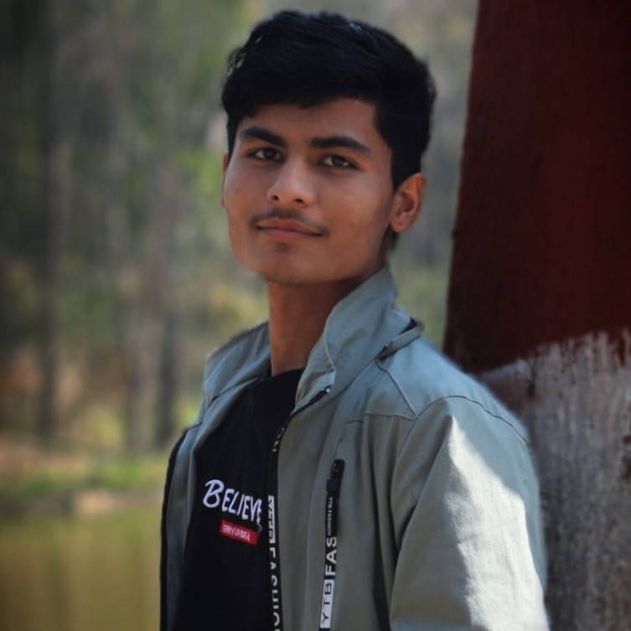
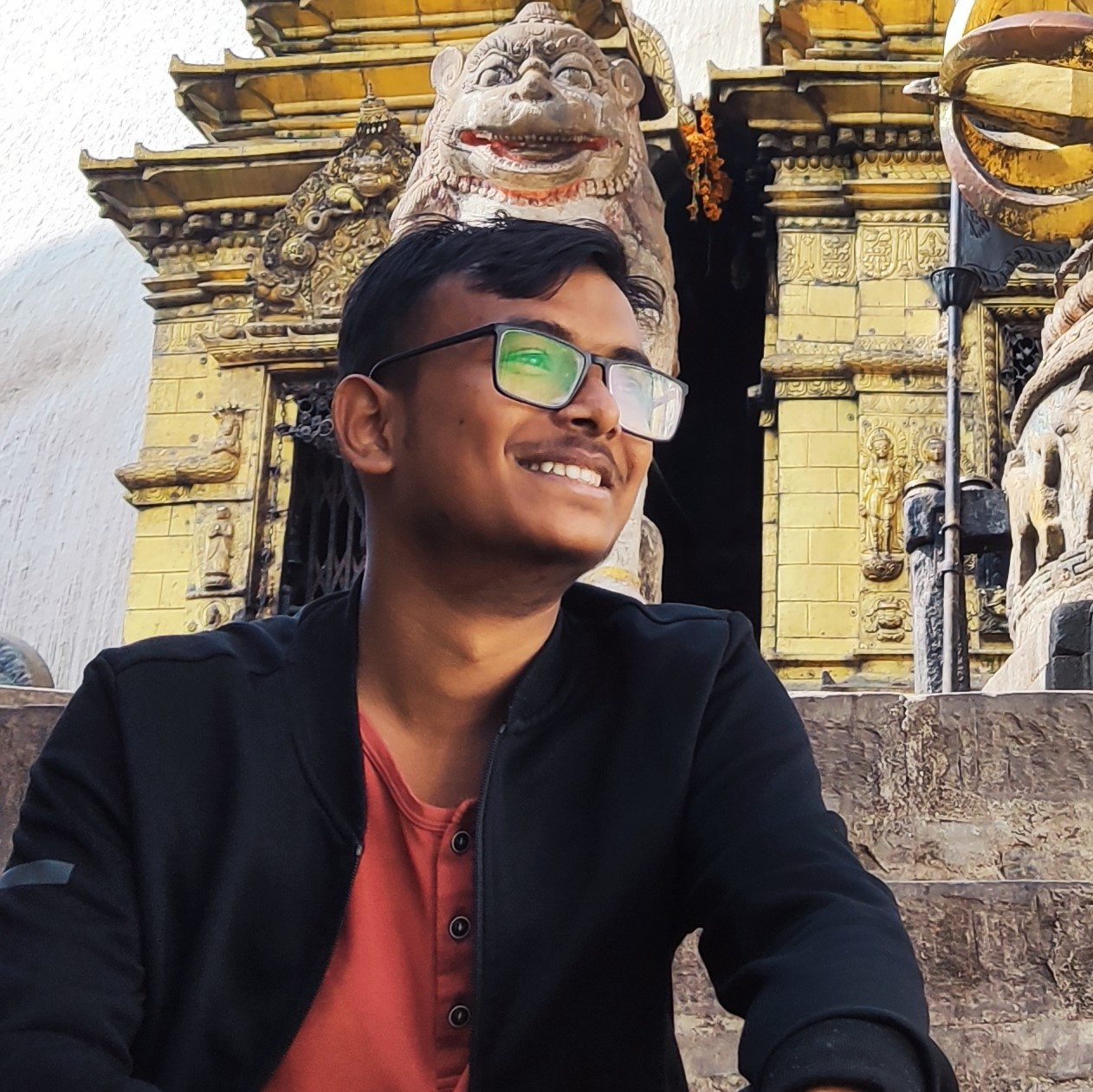
Team members
Anurag Dahal (blaze)
Tilak Thapa (jrTilak)
Utsab Pandey (kaleUtsab)
[Quality Tester/Assistant]
[Coder/Designer]
[Data Miner /Designer]

Slide 3
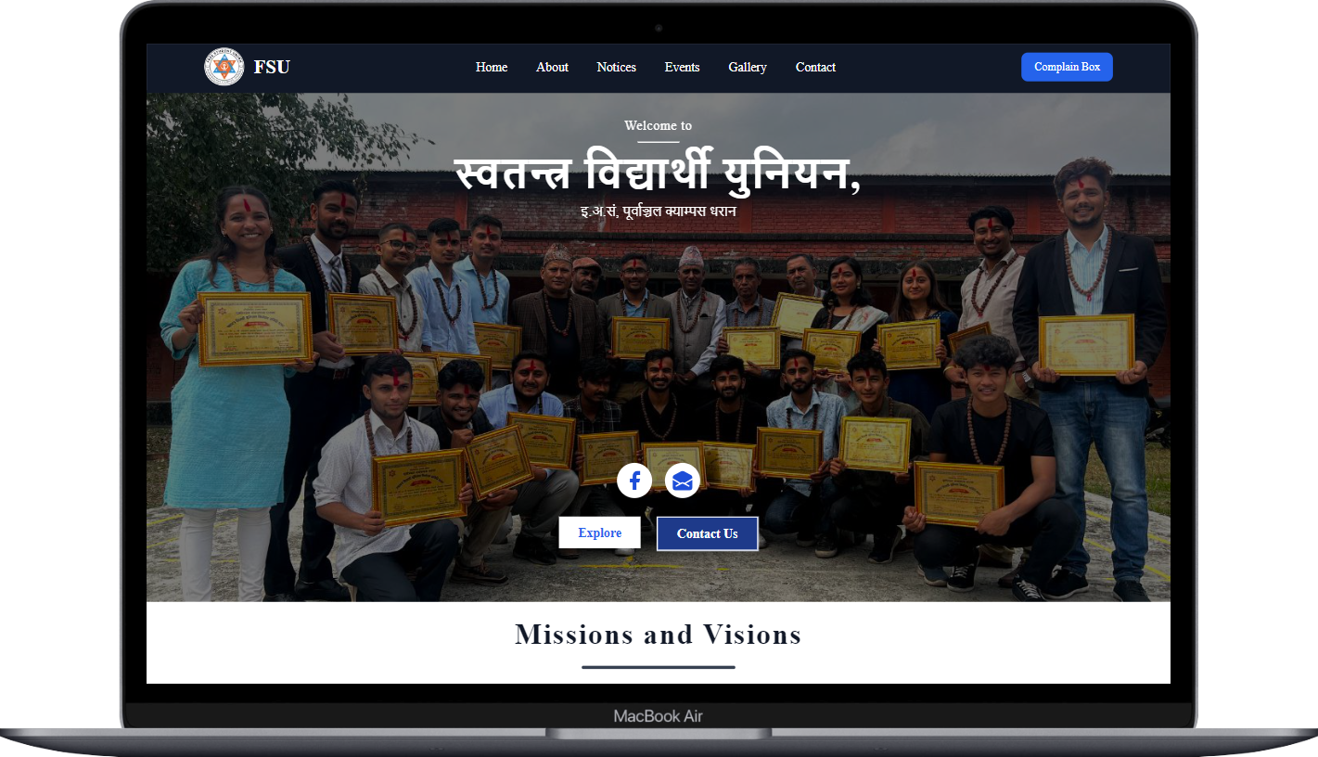
WEL-COME TO WEBSITE DEMONSTRATION OF FREE STUDENT UNION

Slide 4

Modern Websites (must have):
Functionality
Performance
Search Engine Optimization (SEO)
Simple and Straight forward UI (Responsive
Design)

Slide 5

Functionality of our website
Interaction with FSU community.
Provide details About FSU members and its works.
Shows recent notices/news.
Information about upcoming events.

Slide 6
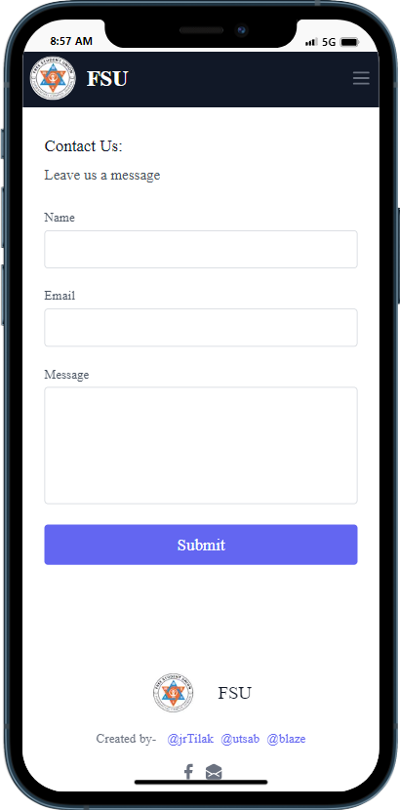
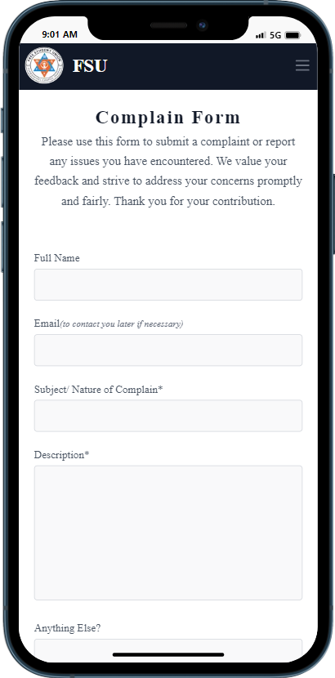
Interaction with fsu
Able to send message through contact from.
Able to send complains, feedback through complain from.

Slide 7
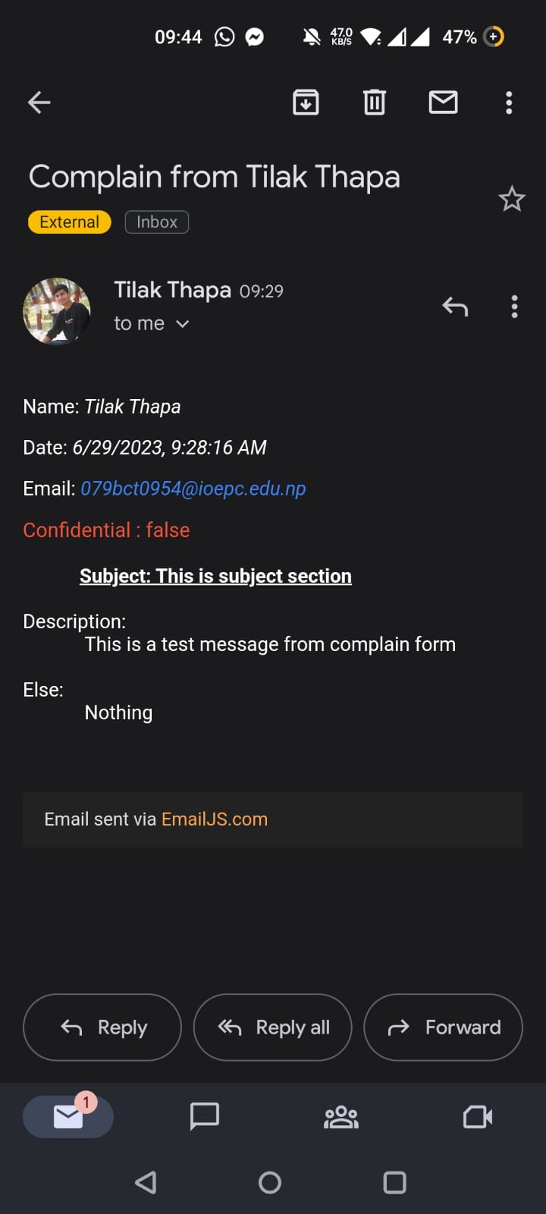
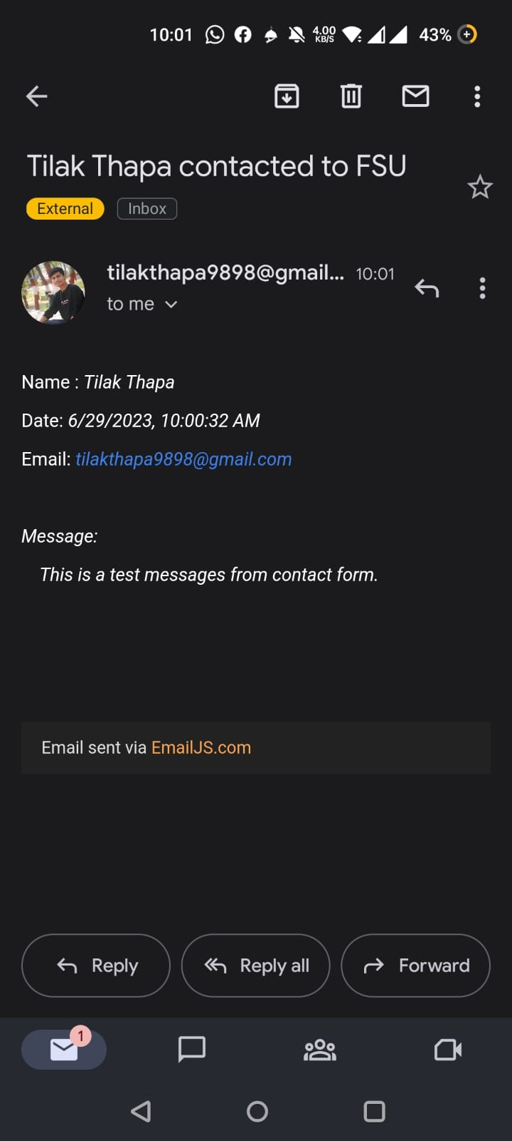
Preview

Slide 8
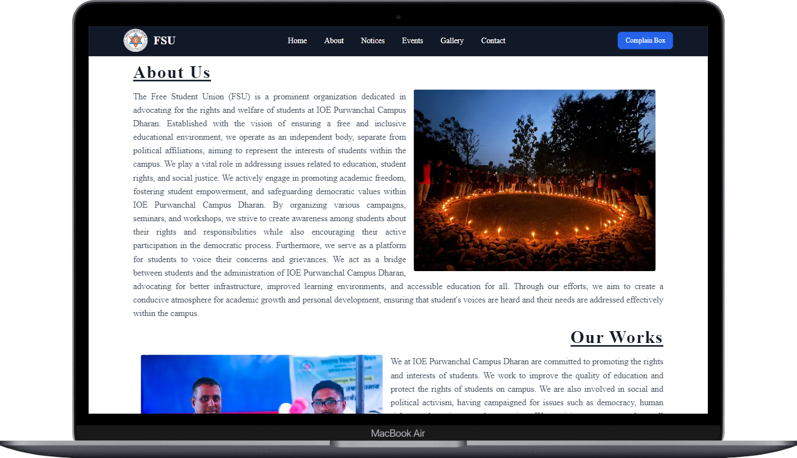
About page

Slide 9
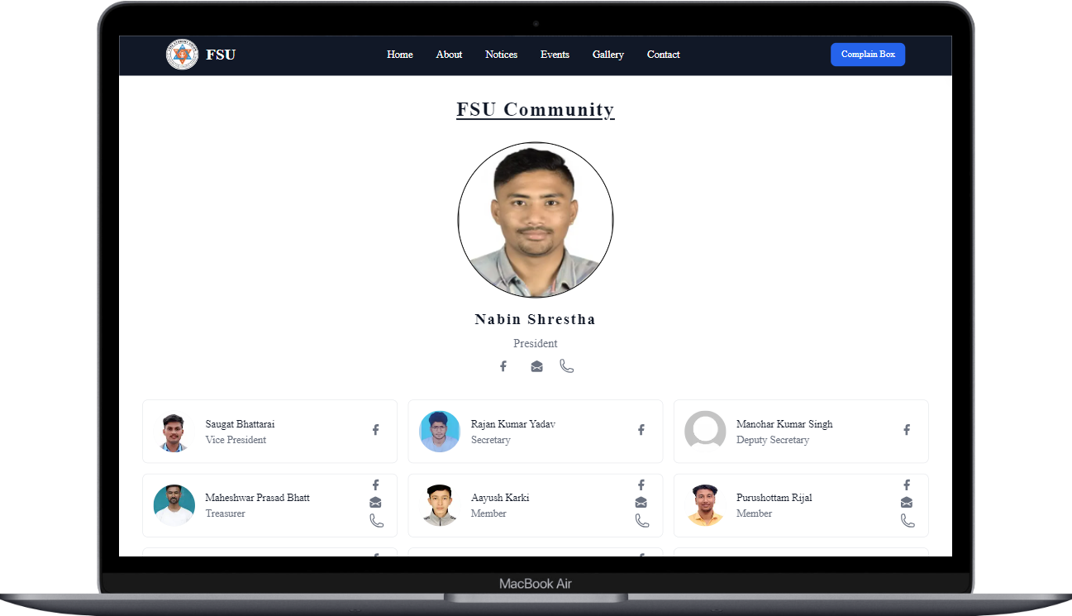
Members details

Slide 10
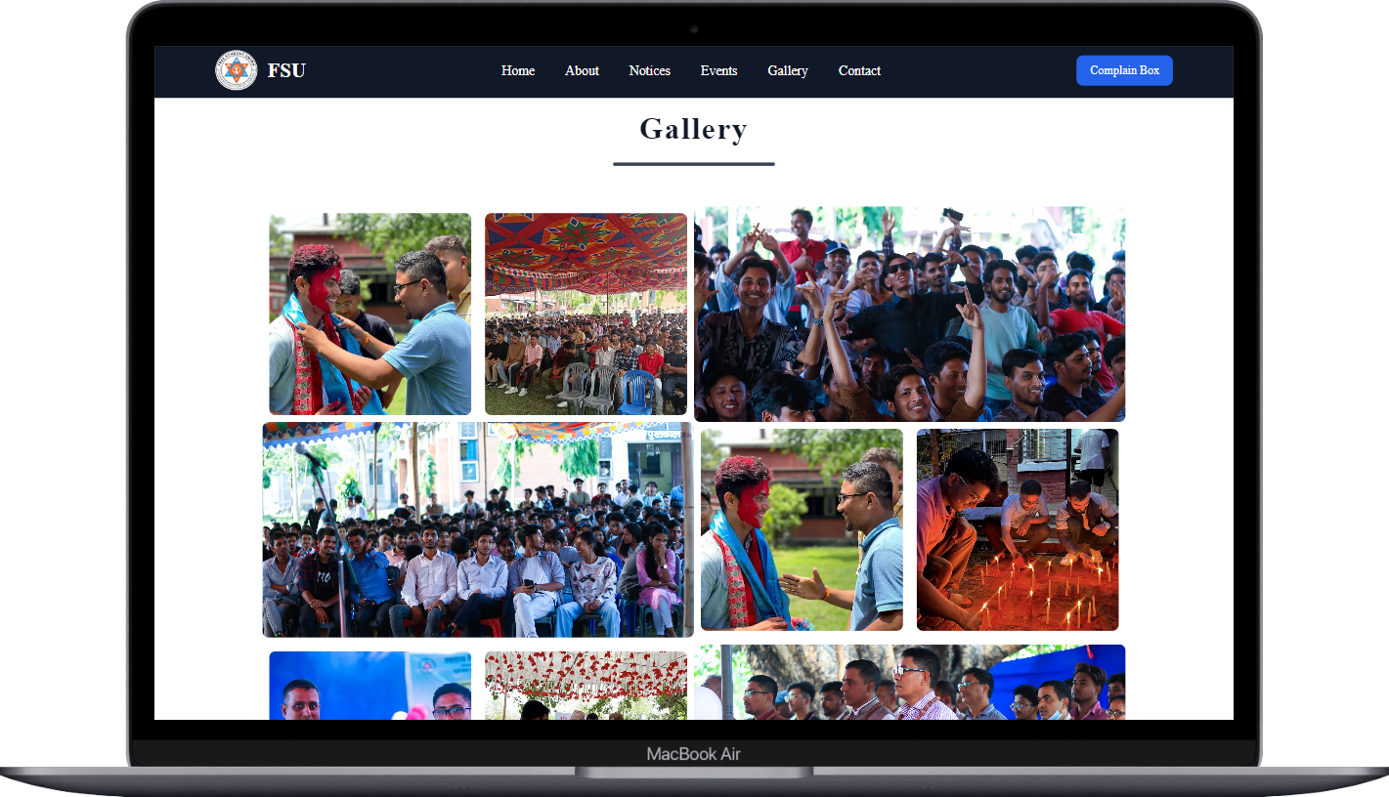
Gallery

Slide 11
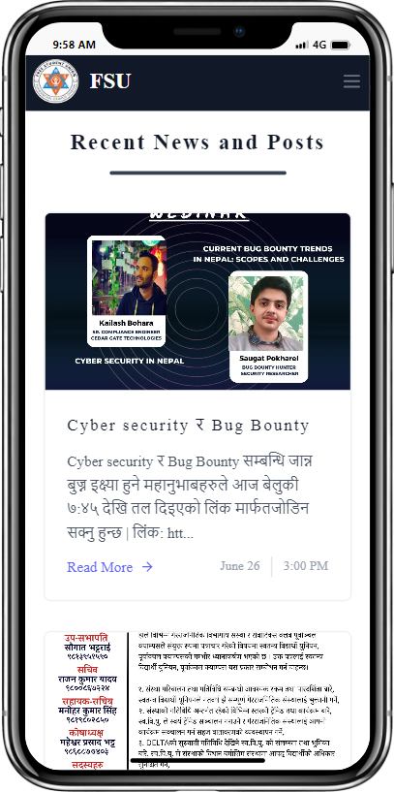
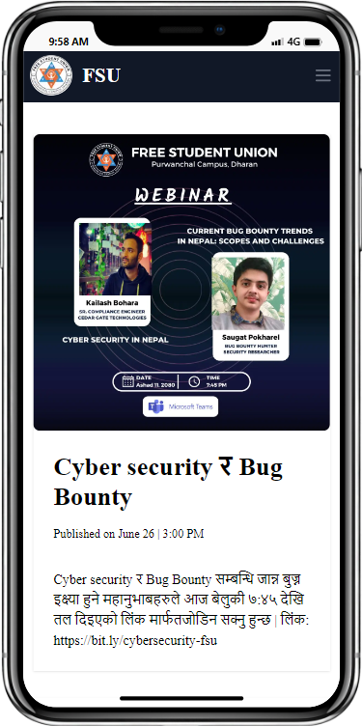
Show recent notices

Slide 12
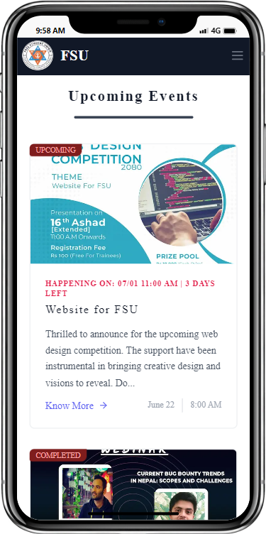
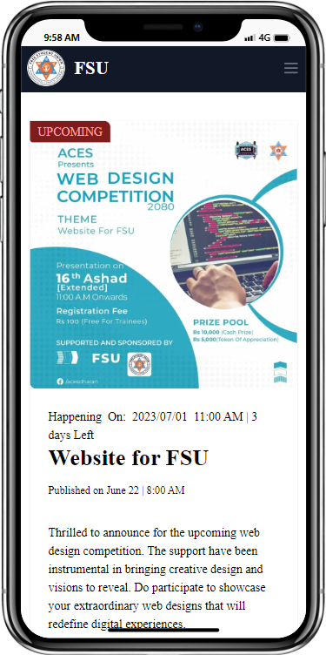
Info about events

Slide 13
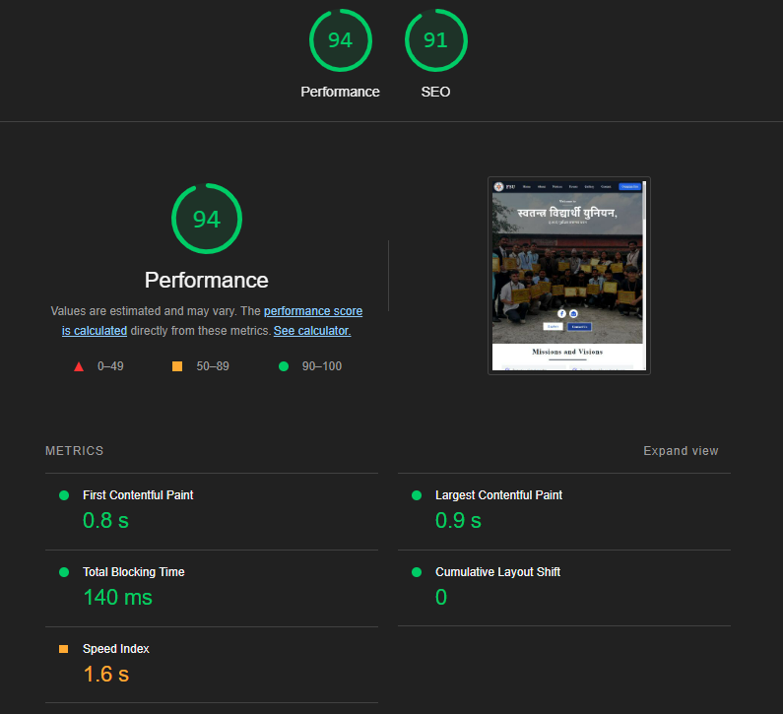
performance
Performance is the crucial part of a website.
Lighthouse report on performance .

Slide 14
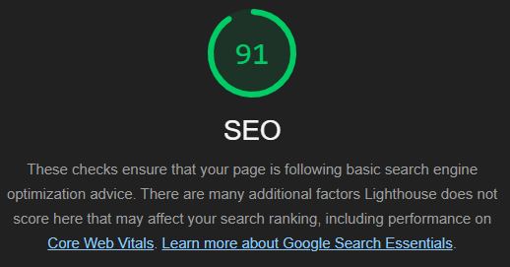
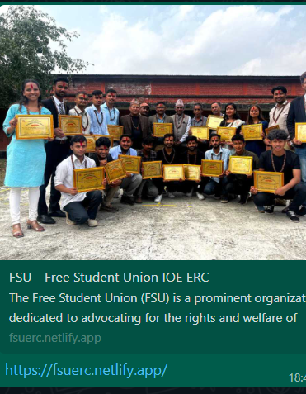
Search engine optimization
Seo is the crucial part of modern websites.

Slide 15
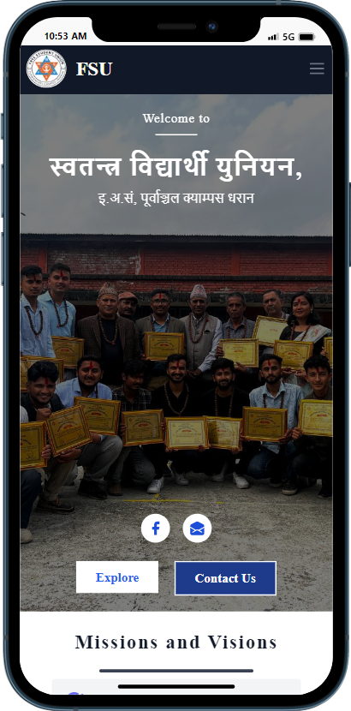
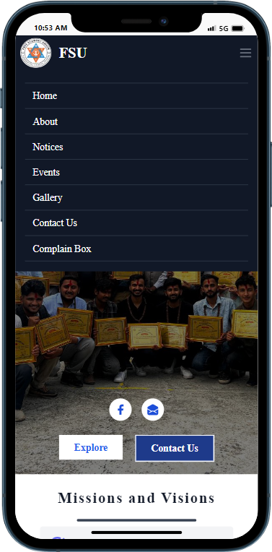
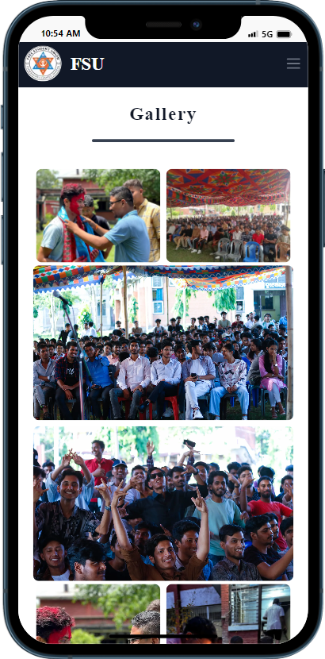
Responsive design

Slide 16
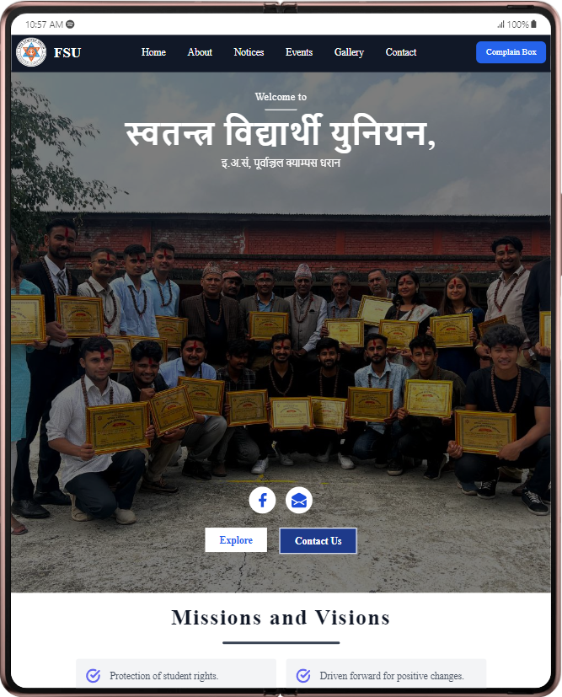
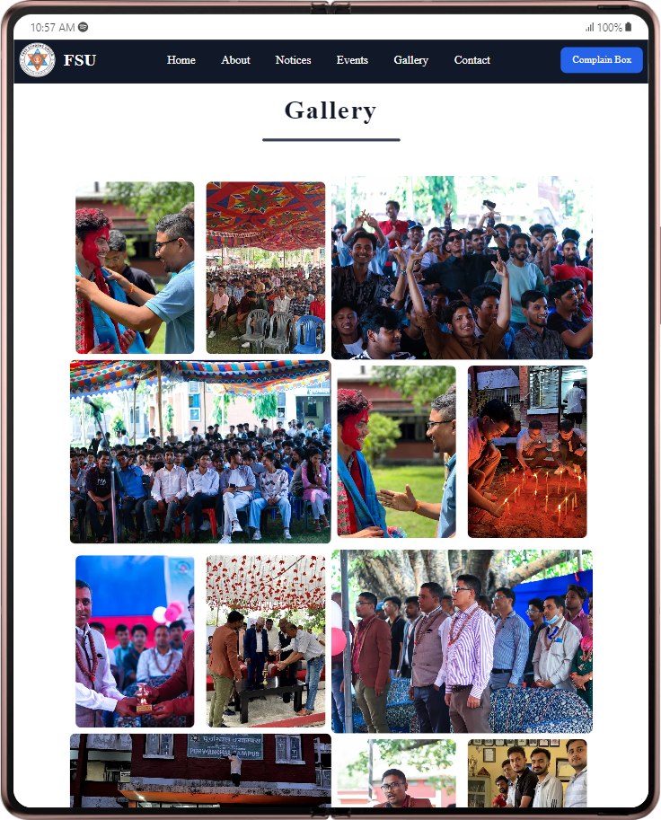
Responsive design

Slide 17
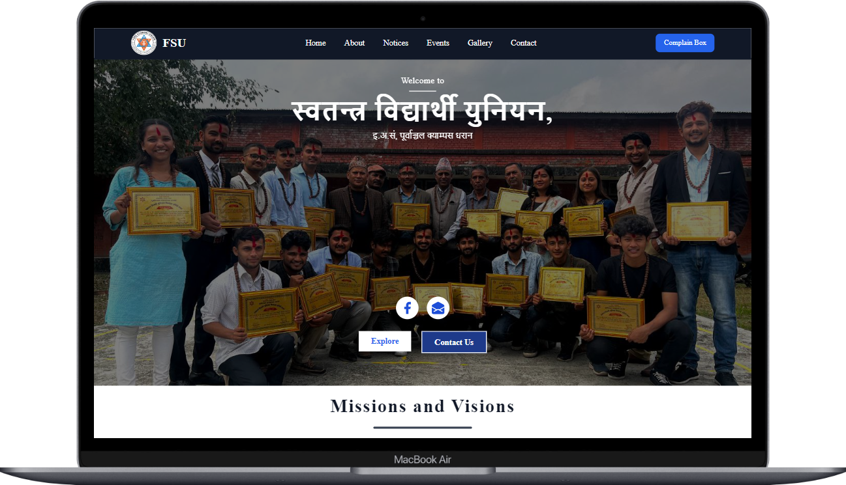
Responsive design

Slide 18




Technologies used:
Next.js / React.js – web frameworks
Tailwind CSS – styling website
Emailjs – sending and receiving emails / messages

Slide 19
Live website demonstration

Slide 20
Conclusion
Included the modern technologies like Next js React JS and Tailwind CSS
Included report of Search engine optimization(SEO)and performance from light house
Responsive UI
Included FSU details
Have functionality to interact with FSU

Slide 21
THANK YOU
Github Repository : github.com/jrTilak/FSU
Website: fsuerc.netlify.app/

